Slide 1
Data Uncertainty and Quality

Slide 2
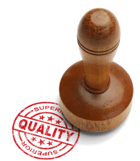
In this smart lesson, you will learn to:
• Design an experiment to collect high quality data.
• Recall what is meant by accuracy, precision and validity.
• Explain the importance of sample size and repeats of trials.

Slide 3
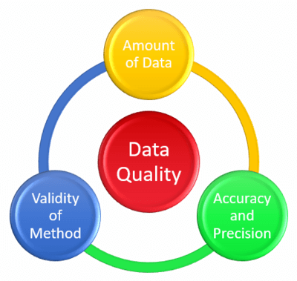
When designing an experiment, it is very important to consider the quality of the data you will be collecting.
This includes considering how much data you need to collect (sample size), how many trials or repeats you will need to carry out, how accurate and precise the measurements will be, and if the experimental method is valid.

Slide 4
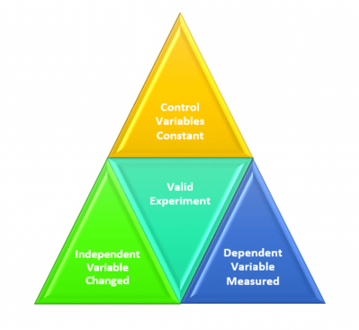
In an experiment there are three types of variables:
independent (manipulated), dependent (measured) and control (kept constant).
In order for an experiment to be valid, only the independent variable is changed - everything else should be kept the same. A good experimental design should consider all the possible variables that can impact the results, and should control as many as possible.

Slide 5

When we are collecting data, every measurement has an intrinsic limit to the number of digits that can be recorded, called the limit of reading.
We can't measure to less decimal places, so the measurement could potentially vary from the reading by the value of the limit of reading.
For example, when using an electronic balance, it commonly measures to the nearest 0.01g.
To show that a reading is accurate to within 0.01g, we use the ±symbol, for example a pencil could weigh 15.26 ± 0.01g.
The range is from (15.26−0.01) to (15.26+0.01) g.
This means the pencil weighs between 15.25 and 15.27g.

Slide 6
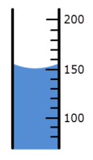
In the measuring cylinder below, the reading is taken at the bottom of the meniscus (curve of liquid), so is 150 mL.
Each division on the measuring cylinder is 10mL, so we take the uncertainty as being half of the division, so it would be ±5mL.
We would write the reading with the uncertainty as 150 ± 5mL. This means the actual reading is between 145mL and 155mL.

Slide 7

When designing an experiment, you want your data to be both accurate and precise.
Accuracy is how close data is to the true value. If you were shooting at a target and aiming for the bullseye, it is how close you get to the bullseye.

Slide 8

Precision means how close the data measurements are to each other.
In the example of the target, it would mean all the results would be grouped closely together.
In this image the data is very close together, so is precise, but has not hit the bullseye, so is not very accurate.

Slide 9
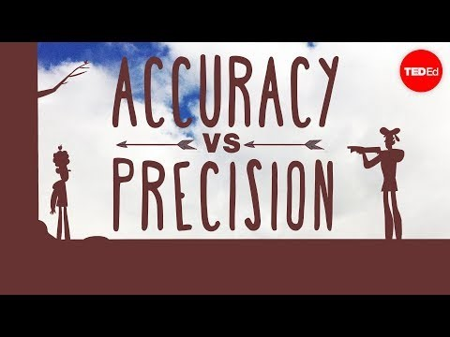

Slide 10
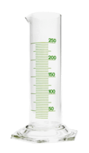
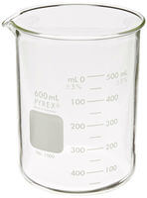
Precision of data.
Data which has a high degree of uncertainty is imprecise, for example 20±5mL.
Data which has a low degree of uncertainty is precise, for example 20.05±0.01g.
When choosing equipment, you should be aware that some equipment is more precise than others, for example a measuring cylinder usually has a smaller uncertainty than a beaker, so is more precise. It you look at a measuring cylinder or beaker, you will see they often have the uncertainty written on them, such as ±0.5mL.

Slide 11
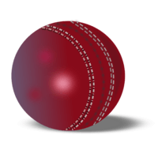
When writing a statement of uncertainty, the uncertainty should be rounded to the same number of value places as the measurement, for example:
The average mass of a cricket ball is 148.345±10g is not correct.
If the error is ±10g, then the mass should also be recorded to the nearest 10g. It should be 150±10g

Slide 12
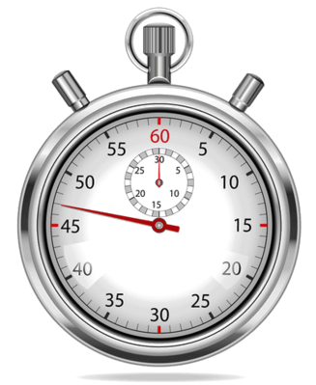
When calculating averages, the uncertainty of the average can never be more specific than the uncertainty of the original measurements.
For example, if the time taken for a ball to drop is measured to±0.1s and there were 5 repeats done, the average could not be recorded as ±0.01s as this is more specific than the original measurements.

Slide 13
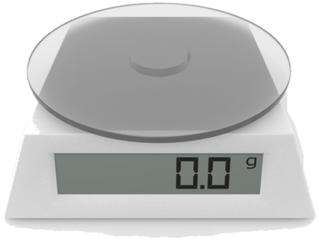
There are two ways of quoting a measurement and its uncertainty.
• Absolute uncertainty is where the uncertainty is in the same units as the measurement, for example 23.1±0.2 g
• Percentage uncertainty is where the uncertainty is divided by the measurement and multiplied by 100, for example 23.1±1% g
When reading uncertainty from digital devices, it is simply the smallest division, such as on this balance it would be ±0.1 g

Slide 14
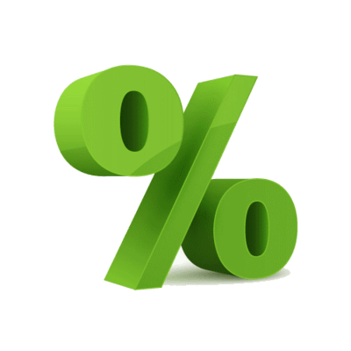
To find out the absolute values of a percentage uncertainty, you must multiply the measurement by the percentage uncertainty.
For example, what is absolute value of 60±5%g ?
First calculate 5% of 60g = 3g
Now write this as 60g±3g
This means the mass is between 57 and 63g

Slide 15

Sample size refers to the number of observations or replicates in an experiment.
It is important because if you have a small sample, then the results you get may not provide an accurate representation of what you are trying to measure.
Consider the example of tossing a coin. The probability of getting a head should be 50%, however, you could get 3 heads in a row by chance. If you just had a sample size of 3 repeats, this would suggest the probability of getting a head was 100%. If your sample size was 100 repeats, you would be much more likely to get a results close to 50%.

Slide 16
It is important to think about a suitable sample size when designing an experiment.
This will depend on several factors, including:
• How you will process the data, as you may need a large enough sample to analyse statistically.
• What resources are available to you, for example if you were testing students, there may only be a limited number available to test.
• The time you have for the experiment and how long each trial takes. This may limit how many trials and repeats you can carry out.
• The type of experiment. Some experiments require testing a percentage of an area, such as an ecological study, whilst some may be an experiment in the lab which is easy to do multiple trials.

Slide 17
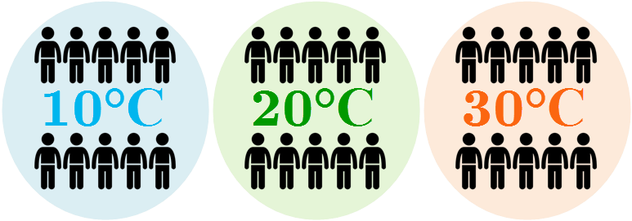
In general, you should try and carry out enough trials to show any patterns and relationships.
You should carry out enough repeats to be confident your data is precise.
For example you may like to test the effect of temperature on heart rate. You could use 10 participants in each trial at a range of temperatures.
This would give enough data to identify any outliers or anomalous results.

Slide 18

When deciding how many repeats to do for an experiment, ideally you should do multiple repeats until you are getting consistent results (precise).
Again, a larger sample size reduces the risk of an anomalous result impacting your final data.
If data is not consistent, check all your control variables carefully to make sure they are constant, and only the independent variable is being changed.

